Slide 1
MICRO-PROJECT 13
Using Regression Models
SERVER
RESPONSE TIME
PREDICTION
Predicting uncertainty in web-service performance
CPU
MEM
Probability & Statistics
Course 25DC210
REQ
TIME
Vian Alen Barnes • Dave V Shah • Project Team
Faculty: Dr. K. Rebecca Jebaseeli Edna
1

Slide 2
MICRO-PROJECT 13 | 25DC210 | PROBABILITY & STATISTICS
Presentation roadmap
Problem → statistical methods → model → evidence → interpretation
01 Problem
02 Statistical toolkit
Response time varies with workload.
Descriptive statistics, correlation, regression.
03 Dataset
04 Evaluation
1,000 simulated time-series observations.
Held-out errors and hypothesis test.
Karunya Institute of Technology and Sciences • Academic Year 2025–2026
2

Slide 3
MICRO-PROJECT 13 | 25DC210 | PROBABILITY & STATISTICS
Problem & rationale
Response time is a random variable—not a fixed constant
Problem
Question
Value
Web-service response times fluctuate as request rate, CPU, memory and network load change.
Can statistical regression estimate response time from measurable workload variables?
A quantitative model can support analysis of uncertainty and workload-related patterns.
Scope: an educational analysis of simulated data—not a validated production monitoring system.
Karunya Institute of Technology and Sciences • Academic Year 2025–2026
3

Slide 4
MICRO-PROJECT 13 | 25DC210 | PROBABILITY & STATISTICS
Aim & objectives
The project turns a dataset into a testable statistical model
Aim
OBJECTIVES
Develop and statistically evaluate a regression model that predicts server response time from workload variables.
• Organise 1,000 workload and response-time observations.
• Summarise centre, spread and range.
• Measure relationships using Pearson correlation.
• Fit multiple linear regression.
• Evaluate predictions on 200 held-out observations.
• Test whether mean residual differs from zero.
Karunya Institute of Technology and Sciences • Academic Year 2025–2026
4

Slide 5
MICRO-PROJECT 13 | 25DC210 | PROBABILITY & STATISTICS
Course alignment & statistical toolkit
Probability & Statistics • Units IV and V
Descriptive statistics
Correlation
Regression
Validation
Mean, standard deviation, range and coefficient of variation.
Pearson r measures linear association between variables.
Estimate response time from several workload predictors.
MAE, RMSE, R² and a one-sample t-test on residuals.
The analysis combines description, association, prediction and statistical validation.
Karunya Institute of Technology and Sciences • Academic Year 2025–2026
5

Slide 6
MICRO-PROJECT 13 | 25DC210 | PROBABILITY & STATISTICS
Methodology workflow
A reproducible pipeline from data preparation to interpretation
1
2
3
4
5
6
7
Dataset
Clean & inspect
Descriptive stats
Correlation
Regression
Test set
Residual test
80% training data (800 rows) → 20% held-out test data (200 rows)
Karunya Institute of Technology and Sciences • Academic Year 2025–2026
6

Slide 7
MICRO-PROJECT 13 | 25DC210 | PROBABILITY & STATISTICS
Dataset & variables
1,000 simulated observations • random seed 42
Request rate
CPU usage
Memory usage
Network load
Response time
50–997 req/s
1.0–99.5%
Mean 41.0%
Workload predictor
56.72–619.18 ms
Predictors: request rate • CPU usage • memory usage • network load
Target: response time (milliseconds). The dataset is simulated; conclusions are specific to this generated data.
Karunya Institute of Technology and Sciences • Academic Year 2025–2026
7

Slide 8
MICRO-PROJECT 13 | 25DC210 | PROBABILITY & STATISTICS
Descriptive statistics
Response time: centre, spread and range
MEAN
STD DEV
RANGE
CV
320.41 ms
118.97 ms
56.72–619.18 ms
≈ 37%
Average response time
Observed spread
Minimum to maximum
SD relative to mean
Interpretation: response time varies substantially, so the model must explain more than the average alone.
Karunya Institute of Technology and Sciences • Academic Year 2025–2026
8

Slide 9
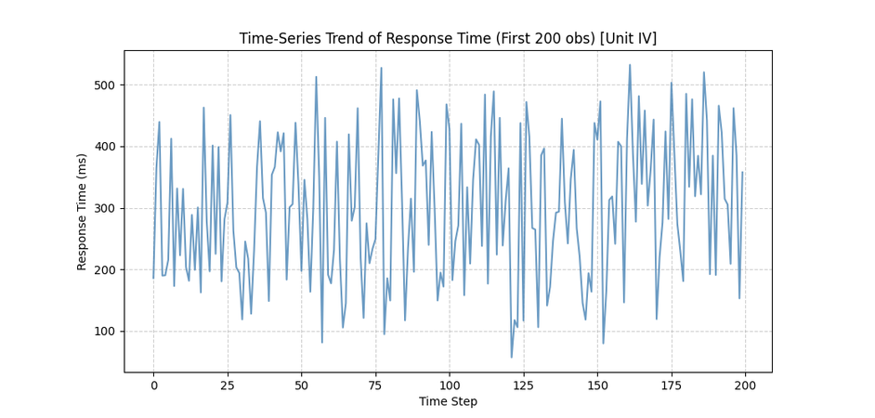
MICRO-PROJECT 13 | 25DC210 | PROBABILITY & STATISTICS
Time-series trend
Original project output • generated response-time sequence
Engineered drift
+0.05 ms per observation was added to the generated series.
Time correlation
r = 0.1249 — weak positive association.
Screenshot from the original project deck.
Karunya Institute of Technology and Sciences • Academic Year 2025–2026
9

Slide 10
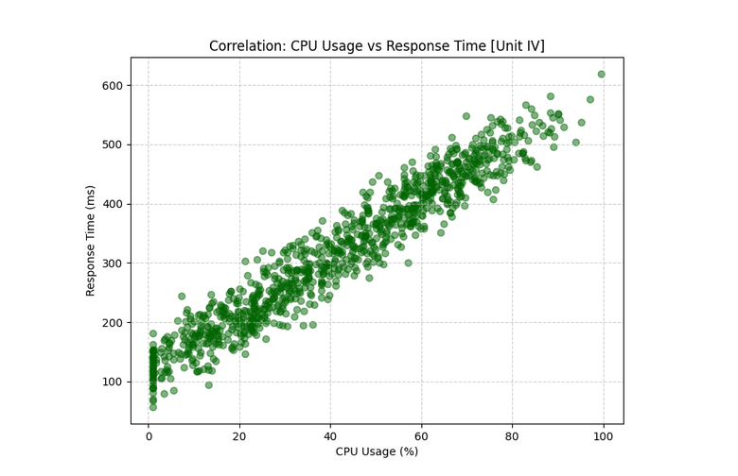
MICRO-PROJECT 13 | 25DC210 | PROBABILITY & STATISTICS
Correlation analysis
Pearson correlation with response time (n = 1,000)
CPU usage
0.9637
Request rate
0.9423
Network load
0.9388
Memory usage
0.9099
Time step
0.1249
Original CPU vs response-time plot.
Strong association is not proof of causation.
Karunya Institute of Technology and Sciences • Academic Year 2025–2026
10

Slide 11
MICRO-PROJECT 13 | 25DC210 | PROBABILITY & STATISTICS
Multiple linear regression
Fitted model using four workload predictors
Ŷ = 73.53 + 0.052(Request Rate) + 2.416(CPU) + 1.447(Memory) + 2.220(Network)
Intercept
Request rate
CPU usage
Memory usage
Network load
73.53
0.052
2.416
1.447
2.220
Coefficients describe fitted relationships. Correlated predictors can make individual coefficients harder to interpret.
Karunya Institute of Technology and Sciences • Academic Year 2025–2026
11

Slide 12
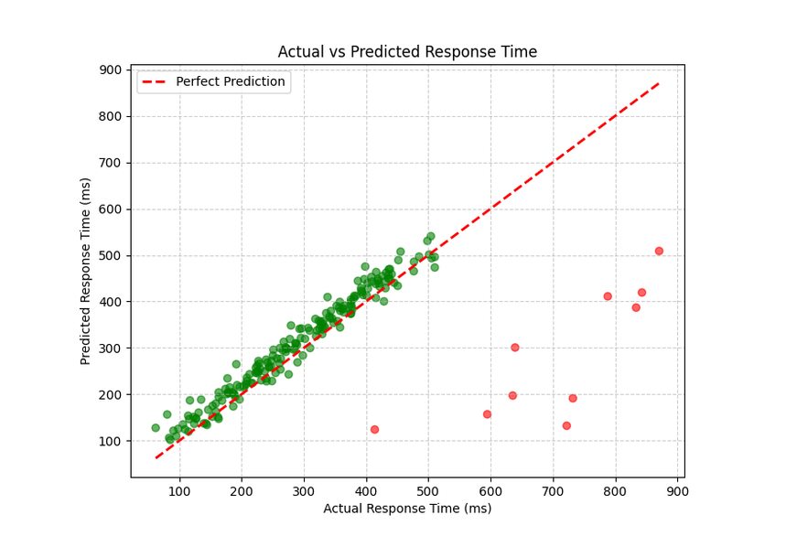
MICRO-PROJECT 13 | 25DC210 | PROBABILITY & STATISTICS
Prediction evaluation
Held-out test set • 200 observations
MAE
RMSE
R²
20.21 ms
25.26 ms
0.9505
Average absolute error
Penalises larger errors
95.05% variance explained
The reported R² indicates a strong fit on the simulated test set.
MAE and RMSE summarise the typical prediction error in milliseconds.
Original predicted-vs-actual output plot.
Karunya Institute of Technology and Sciences • Academic Year 2025–2026
12

Slide 13
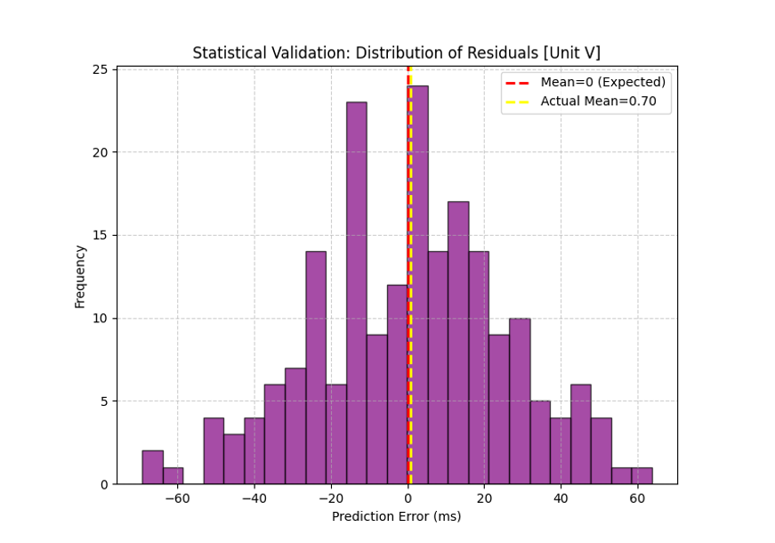
MICRO-PROJECT 13 | 25DC210 | PROBABILITY & STATISTICS
Hypothesis test: mean residual
One-sample Student’s t-test • α = 0.05
H₀
H₁
Reported test
Mean prediction error = 0
Mean error ≠ 0
t = 0.3931 • p = 0.6947
INTERPRETATION
p > 0.05: fail to reject H₀. The test finds no evidence of a non-zero mean residual; it does not prove every prediction is unbiased.
Karunya Institute of Technology and Sciences • Academic Year 2025–2026
13

Slide 14
MICRO-PROJECT 13 | 25DC210 | PROBABILITY & STATISTICS
Limitations & future scope
Interpret results within the evidence available
What this shows
Limitations
Next steps
• Strong correlations in generated data
• Regression prediction and held-out metrics
• Residual mean test
• Simulated rather than live telemetry
• Relationships are data-generation dependent
• No proof of causation or external validity
• Collect real server measurements
• Check residual assumptions
• Test time-based holdout and drift
• Compare alternative models
Potential application: performance baselines and capacity-planning experiments.
Karunya Institute of Technology and Sciences • Academic Year 2025–2026
14

Slide 15
MICRO-PROJECT 13 | 25DC210 | PROBABILITY & STATISTICS
Conclusion & references
Statistical modelling makes workload-related variation measurable
• Four workload variables show strong positive correlations with response time.
References
• Reported test-set R² = 0.9505; MAE = 20.21 ms; RMSE = 25.26 ms.
25DC210 course materials and supplied project files.
Montgomery, Peck & Vining, Introduction to Linear Regression Analysis.
Original project dataset and analytical outputs.
• The t-test reports p = 0.6947; the null hypothesis is not rejected.
• Results are specific to the generated dataset; live validation remains future work.
THANK YOU • Questions & discussion
Karunya Institute of Technology and Sciences • Academic Year 2025–2026
15

